Slide 1

Basic Details of the Team and Problem Statement
Ministry/Organization Name/Student Innovation:
Ministry of AYUSH
PS Code: SIH1341 Problem Statement Title:
PG dissertation Management System Description.
Team Name: GrowGuards Team Leader Name: Uzzma Saiyed Institute Code (AISHE): C-58356 Institute Name:
Faculty of Computer Applications and IT
Theme Name: Smart Education

Slide 2





























Idea/Approach Details
IDEA DESCRIPTION:
A PG Dissertation Management System (DMS) streamlines the entire dissertation process from topic selection to publication, ensuring high-quality outcomes. Its key features include topic selection, approval tracking, progress monitoring, evaluation support, and publication access. The DMS improves efficiency, enhances quality, reduces workload, and fosters better communication, benefiting both students and supervisors.
PROCESS FLOW CHART
User Login
Select Dissertation Step
Topic
Selection
Approvals and Ethical Issues
Monitoring Research Progress
Evaluation of dissertation
Publication
TECHNOLOGY STACK
past dissertations, research areas & faculty expertise.
guidance on approval processes and ethical compliance
centralizes documents and communications
standardized evaluation processes and rubrics
access to publication outlets.
Front-End
Tech Stack
Middleware
Tech Stack
Back-End
Tech Stack
Database
Servers
user completes the required tasks for the selected step.
submits the completed tasks to the DMS.
DMS provides feedback or confirmation to the user.
Flutter
Rest API
Python
Firebase+ MySQL
Apache
logout

Slide 3
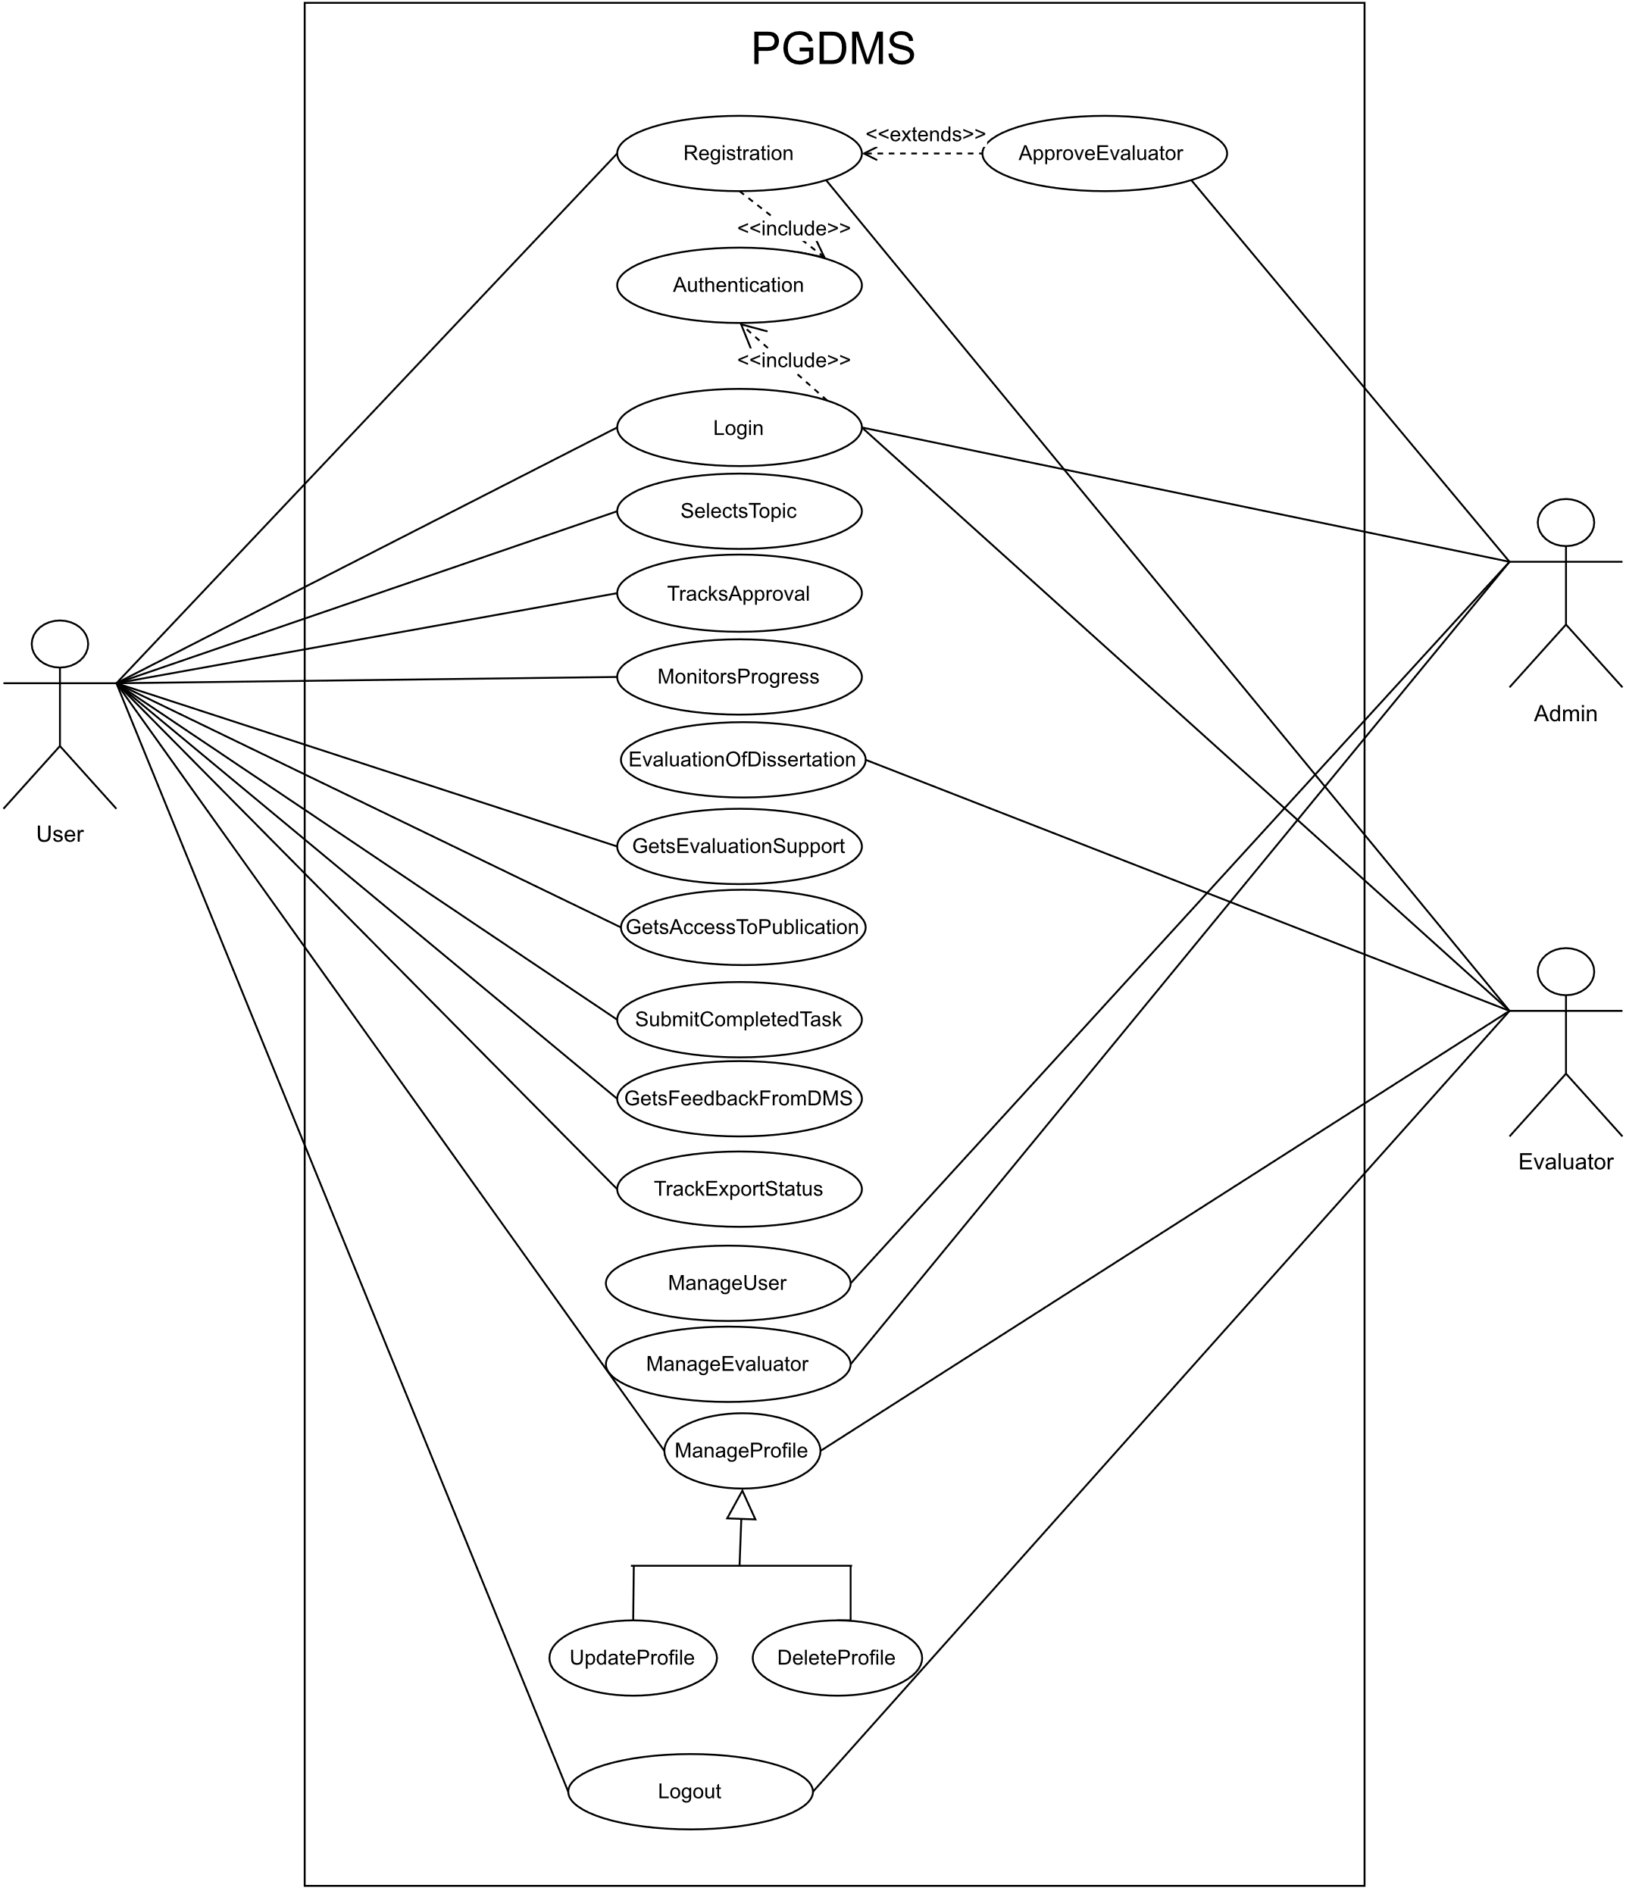




Idea/Approach Details
Use Case
SHOW STOPPER
The most vital feature in a PG Dissertation Management System (DMS) is "Dissertation Evaluation," ensuring standardized and fair assessment of research quality, which is critical for academic integrity and student progress.
Submission of Dissertation
student submits their dissertation.
Assignment of Reviewers
Reviewer Evaluation
Approval
Feedback and Rating
Student Revision
Final Evaluation
Reviewers provide feedback, ratings, and comments to the student.
If needed, the student revises the dissertation based on feedback.

Slide 4
Team Member Details
Team Leader Name: UZZMA SAIYED
Msc. Stream (ECE, CSE etc): Year (I,II,III,IV): I
Team Member 1 Name: SMIT JOSHI
Msc. Stream (ECE, CSE etc): Year (I,II,III,IV): I
Team Member 2 Name: TEJASV MODI
Msc. Stream (ECE, CSE etc): Year (I,II,III,IV): I.
Team Member 3 Name: KHUSHI LODHA
Msc. Stream (ECE, CSE etc): Year (I,II,III,IV): I
Team Member 4 Name: DIGVIJAY JAKHANIYA
Msc. Stream (ECE, CSE etc): Year (I,II,III,IV): I
Team Member 5 Name: VISHVA RAVAL
Msc. Stream (ECE, CSE etc): Year (I,II,III,IV): I
Team Mentor 1 Name: PROF. RACHANA CHAUDHARI
Category : Academic Expertise: Web and Mobile Development Domain Experience (in years): 9

